Slide 1
ROCO218: Control Engineering Dr Ian Howard Lecture 10 Root locus

Slide 2
Meaning of Root Locus
Consider the simple controller system where C(s) is a controller
Often need to design controller C(s) to improve system performance/stability
Poles of system need to be stable and located appropriately!
The closed-loop transfer function of the basic feedback system above is:
The characteristic equation, whose roots are the poles of this transfer function, is therefore:

Slide 3
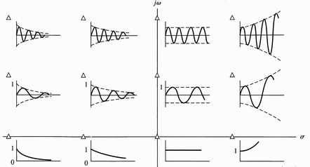
Remember: S-plane and stability
For stable systems we want poles of the transfer function of our feedback system located in the left of the s-plane
Also might have other – e.g. time/settle time requirements - for the system
Root locus is a graphical presentation of the closed-loop poles as a system parameter (normally a forward gain K ) is varied.
Root locus is a powerful method of analysis and design for stability and transient response.
A simple set of rules allow the loci to be sketched (will mention first 2 rules only as the do by hand approach is dated)

Slide 4
Calculating root locus: Example1
For the simple proportional controller system with forward path gain K
This system has the open-loop transfer function
This leads to the closed-loop transfer function
Adjustable gain K will therefore affect location of the system poles
Poles occur when (s+a+K)=0 so therefore s = -(a+K)
There are no zeros for this transfer function

Slide 5
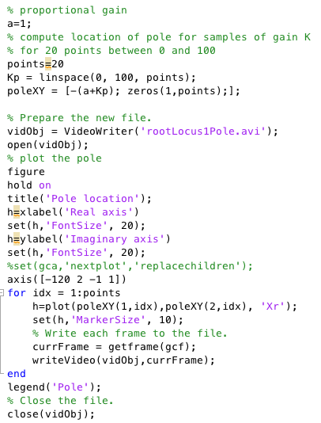
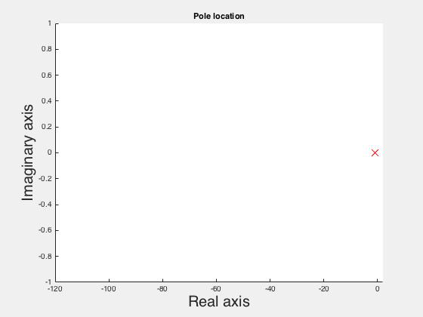
DIY Matlab plot of poles for a range of gain K
By common convention
Poles are marked on a graph with an 'X'
Zeros are marked with an 'O
Root-locus found by plotting poles of closed-loop transfer function for K starting at zero and going to to large value
Here plotted here for range K = 1 to 100 in video
Pole at -1

Slide 6
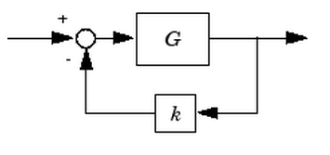
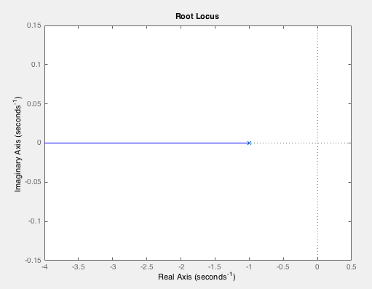
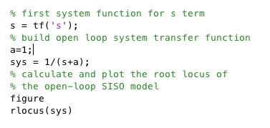
Using Matlab rlocus function
Plotting a root locus with Matlab is easy using rlocus, rlocfind, rltool
NB: In general root locus is hard to determine by hand
Matlab puts gain in feedback path and not in the forward path
Pole at -1

Slide 7
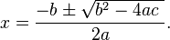
Calculating root locus: Example 2
For the proportional controller system
This system has the open-loop transfer function
Remember: For a quadratic equation:
The closed-loop transfer function is therefore
Therefore location of poles give by
Thus some values of K will lead to complex solutions
There are no zeros for this transfer function

Slide 8
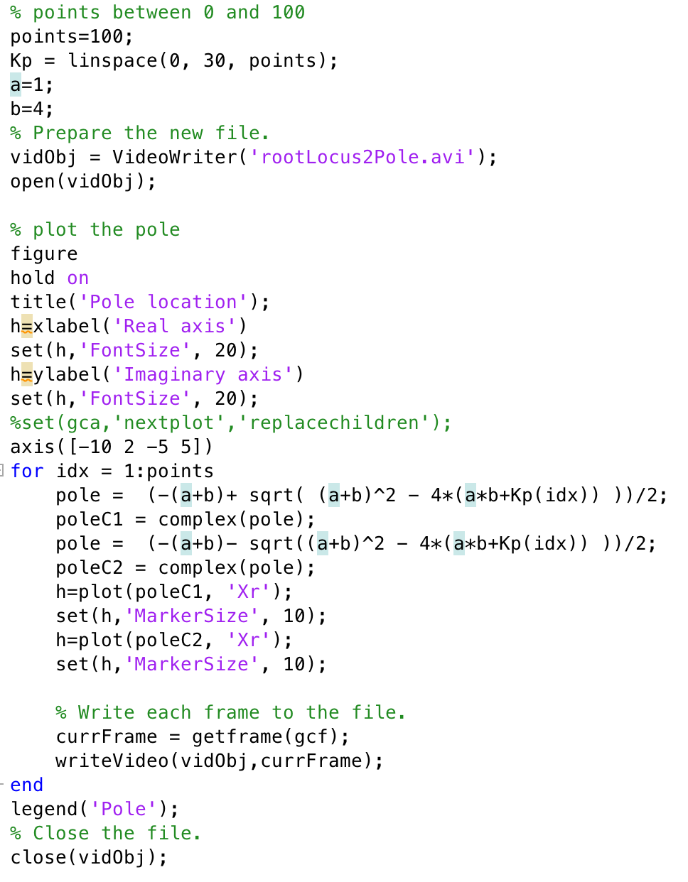
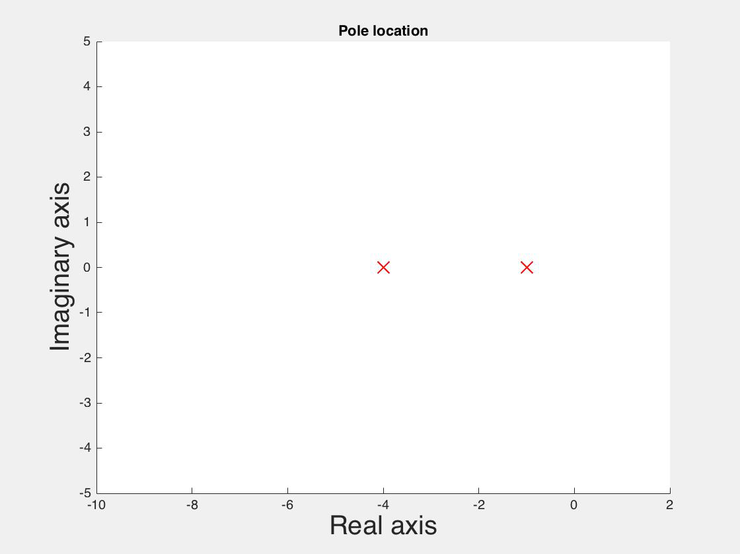
DIY Matlab plot poles for a range of K values
Pole at -4
Pole at -1

Slide 9
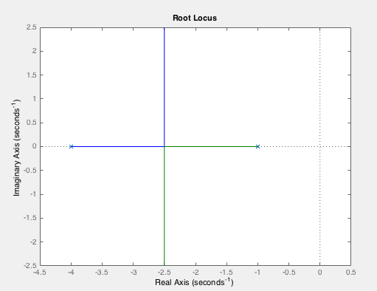
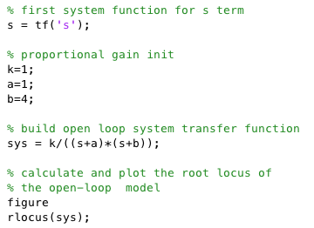
Using Matlab rlocus function
Again Matlab puts gain in feedback path and not in the forward path
Pole at -4
Pole at -1

Slide 10
ROCO218: Control Engineering Dr Ian Howard Lecture 10 Two Root Locus sketching rules

Slide 11
Root Locus sketching rules
Sketching involves using a few mathematical properties of the transfer function to draw the main form of the root locus
Matlab can do this but by hand sketch still can give/demand insights of the important features
General rules for the construction of a root locus were developed by Evans.
Explicit solutions are difficult to obtain for higher-order system
However, in control design we are also interested in how to modify the dynamic response so that a system can meet the specifications for good control performance.
Only consider hand determination of start and end points of plots here

Slide 12
Root Locus sketching rules
Give the feedback system with open loop transfer function G(s)
Poles given when
We can express the root locus problem in several equivalent ways
Writing the transfer function as
Numerator term
Denominator term
Therefore we can write
The equations above are sometimes referred to as “the root locus form of a characteristic equation.”
The root locus is the set of values of s for which the above equations hold for some positive real value of k.

Slide 13
Root Locus sketch: Starting point open loop pole
From the expression
It can been seen that when k=0 we have
So roots of the closed loop system are then the poles of G(s)
Rule 1: Starting Point (k=0)
The root locus starts at open loop poles.

Slide 14
Root Locus sketch: Ending point open loop zero
From the expression
Dividing through by k
It can been seen that when k ➔ ∞ the 1st term goes to zero so we have
This expression has roots when N(s) = 0
So the roots are the open loop zeros of G(s)
Rule 2: Ending Point (k ➔ ∞ )
The root locus ends at open loop zeros.

Slide 15
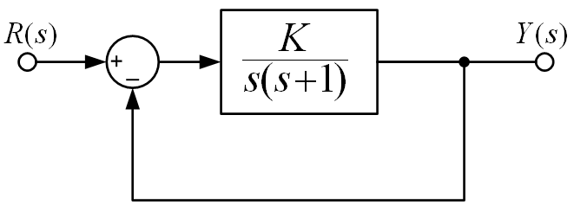
Plotting a Root Locus by-hand example
Examine the following closed-loop system, with unity negative feedback.
The closed-loop transfer function is given as:
The roots of the characteristic equation are:
The characteristic equation - which is the denominator of the closed-loop transfer function

Slide 16
Plotting a Root Locus by-hand example
K=∞
When greater K=1/4 poles turn imaginary
: Poles of open-loop transfer function
Open loop poles at 0 and -1
In this case no zeros so paths end up at +/- infinity on imaginary axis
K=0
K=0
K=∞

Slide 17
Example: Examining some root locus plots
Consider the open loop transfer function
By inspection of the open-loop transfer function we see that when the gain k = 0 there are 4 closed-loop poles at:
s = 0, s = -5, s = -15 & s = -20
Similarly there is a closed-loop zeros at
s = -7
Since there must be 3 zeros in total the other two zeros must be at s = ∞

Slide 18
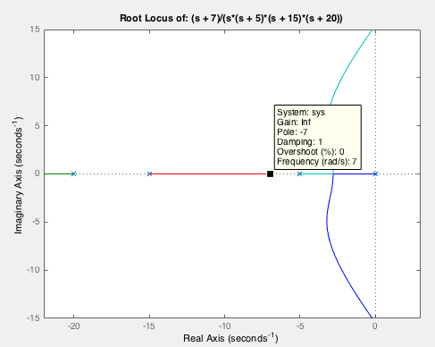
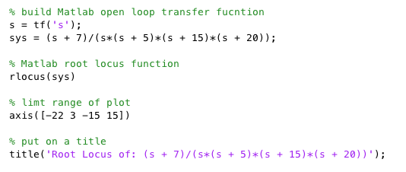
Examining some root locus plots
Consider the open loop transfer function
This leads to the following plot
Now look at root locus plot using Matlab

Slide 19
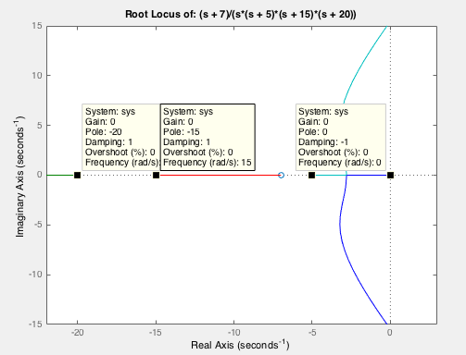
Examining some root locus plots
As expected poles on the root locus plot when the gain is zero start at the open loop poles of the system:
s = 0
s = -5
s = -15
s = -20

Slide 20
Examining some root locus plots
As expected a pole on the root locus plot when the gain is zero ends at the open loop zero of the system:
s = -7
And two go off to infinity
Off to infinity
Off to infinity

Slide 21
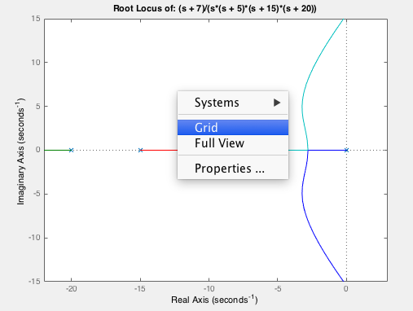
Examining some root locus plots
We can switch on a grid to examine damping

Slide 22
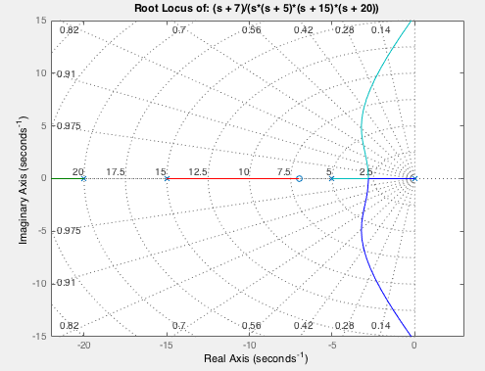
Examining some root locus plots
This gives lines from origin that represent constant damping ratio
For systems that approximate 2nd order systems, damping ratio and natural frequency can be directly read from root-locus plots

Slide 23
ROCO218: Control Engineering Lecture 10 Root locus of inverted pendulum

Slide 24
Rod inverted pendulum
y_{m}
For an inverted rod pendulum where
The angle to the vertical is denoted by θ
The coefficient of viciously is denoted by μ
The mass of the pendulum is denoted by m
The moment of inertial of the rod about the center of mass is denoted by I
The length to the centre of mass is denoted by l
The velocity of the pivot is given by V_{p}
m
l
y_{p}
x_{m}
θ
x_{p}
The linearized equation of motion is given by

Slide 25
Taking Laplace transforms
From dynamic equation
Take Laplace transforms assuming zero initial conditions.
Dividing through by ml

Slide 26
Deriving the transfer function
Writing velocity as
So the transfer function for output angle for velocity input is given by

Slide 27
Interpreting the transfer function
We now re-write transfer function with a unity term in
front of the highest power of s
Comparing with canonical form we can find natural frequency by inspection
NB: We could also find damping ratio too
Since

Slide 28
Point mass condition
From expression for natural frequency
So for point mass there is no MoI about the centre of mass
Same result as for a simple point mass pendulum!

Slide 29
Rod pendulum condition
From expression for natural frequency
For rod about its CoG with rod length 2l, since l is pivot distance to CoG
Where l_{full} is the full length of the rod
(= 2x distance to CoG)

Slide 30
Evaluation with pararmeter values
y_{m}
m
l
y_{p}
x_{m}
θ
x_{p}
We will now consider the following values:
Length of pendulum rod 0.64 m
Mass of pendulum rod 0.314 kg
Coefficient of viscous friction: 0.005

Slide 31
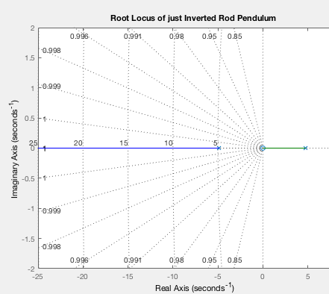
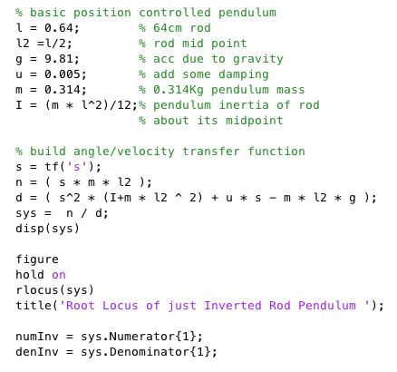
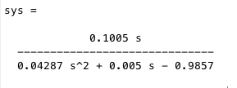
Matlab root locus plant only analysis
We can now perform Matlab root locus analysis of the uncontrolled pendulum
Stable
Unstable
With only proportional gain the pendulum system is unstable and cannot be controlled!

Slide 32
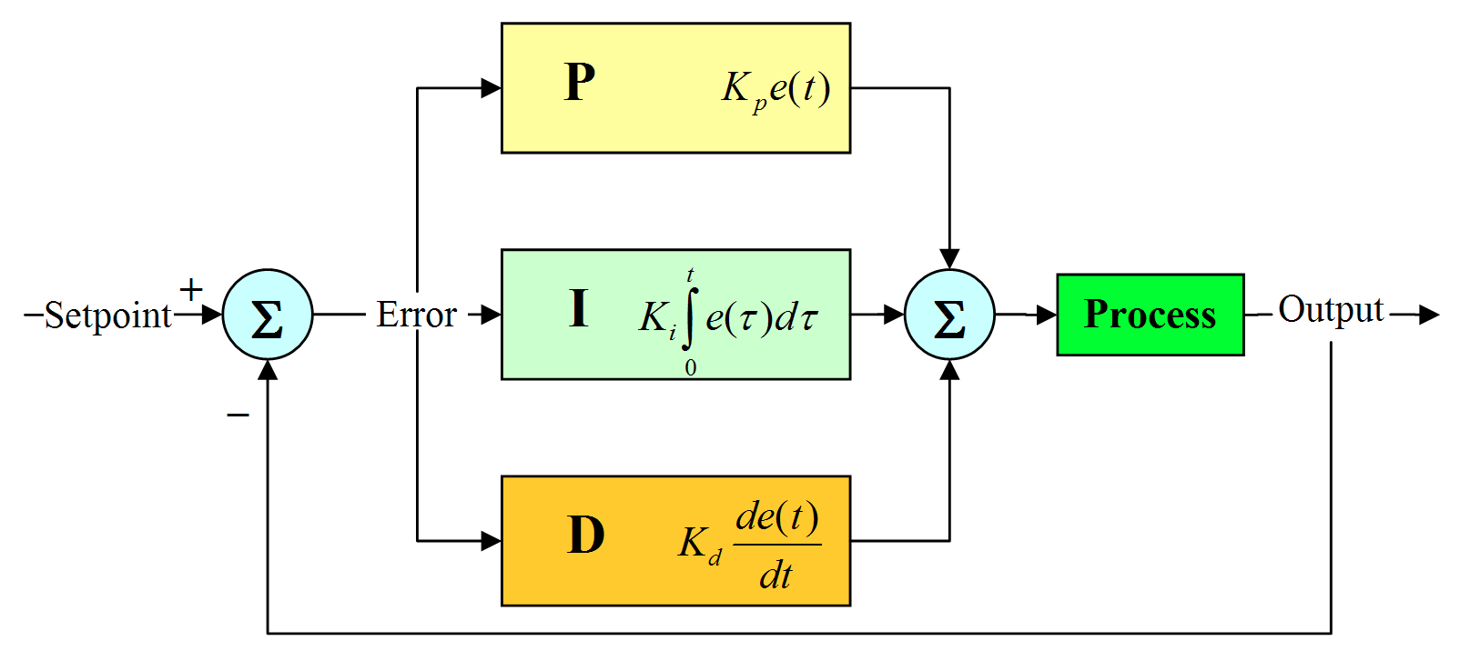
Remember: PID differential equation
u(t)
e(t)
Relationship between input error e(t) and output control signal u(t) is thus captured by the differential equation:

Slide 33
Remember: Transfer function of PID controller
Differential equation that described PID controller
Taking Laplace transformations and rearranging gives the transfer function for the PID controller:

Slide 34
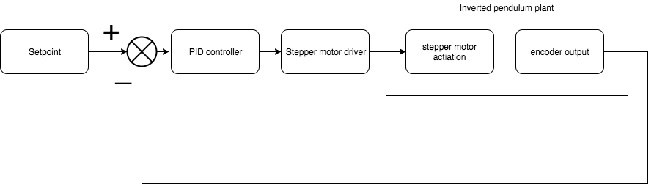
PID control of an inverted pendulum
Want to use feedback with PID controller to stabilize pendulum
Overall system flow graph is as follows
The open loop forward path is therefore due to the serial combination of the PID controller and the inverted pendulum plant

Slide 35
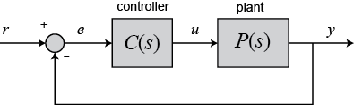
PID control of an inverted pendulum
PID controller has the transfer function
Inverted pendulum plant has the transfer function
Product of these series elements gives
To design a PID controller we need to find suitable K_{p}, K_{i} and K_{d} gains

Slide 36
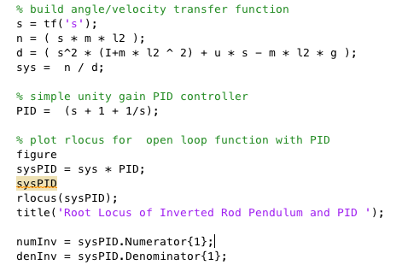
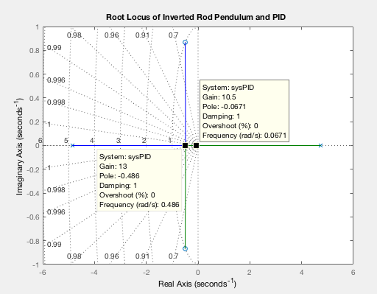
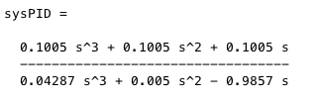
Matlab root locus with PID controller
We can now perform Matlab root locus analysis of the PID controlled pendulum
Pole becomes stable as locus crosses imaginary axis
Here gain is about 13 after which complex poles are formed

Slide 37
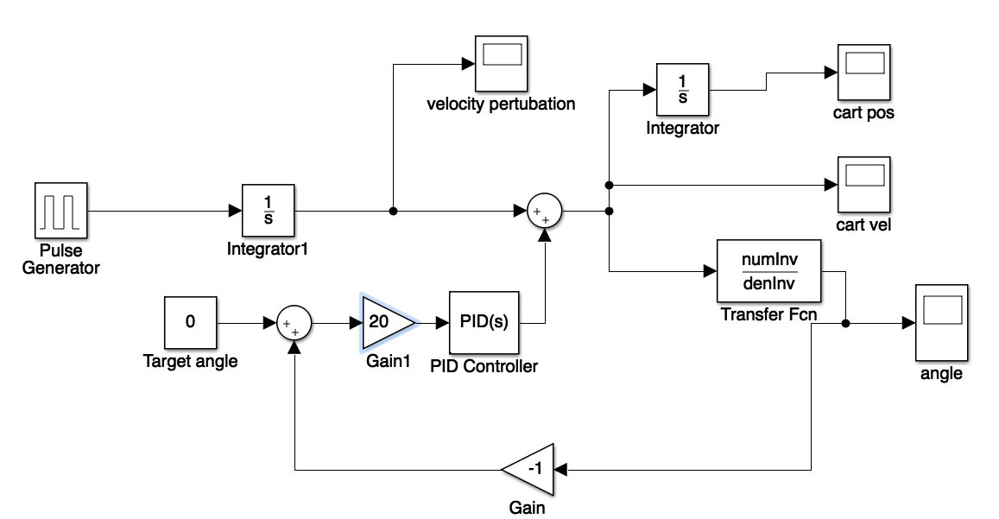
Simulink: PID with stable gain
Add small differentiable
velocity disturbance
Set target angle
To 0 degrees

Slide 38
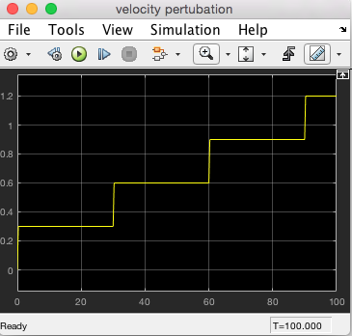
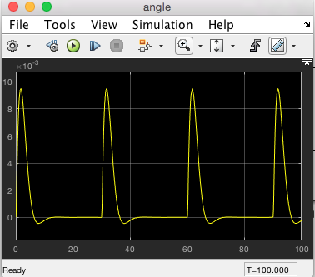
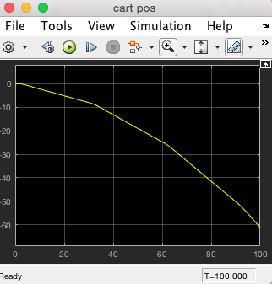
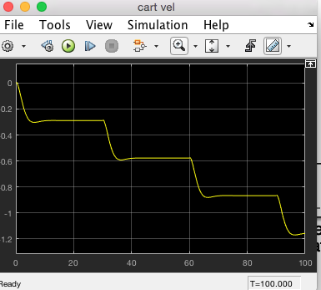
Signals: stable gain = 20

Slide 39
Normal hanging-down rod pendulum
This time effect of gravity assists movement
to stable equilibrium

Slide 40
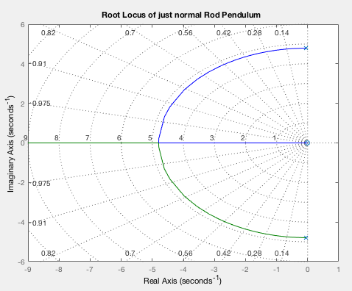
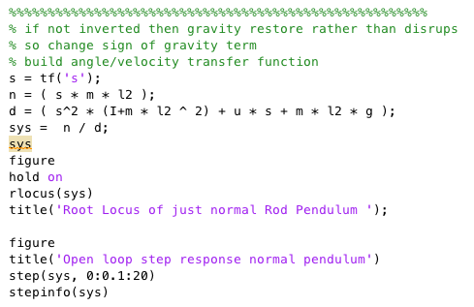
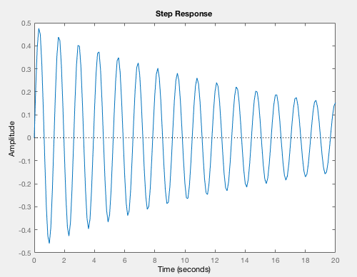
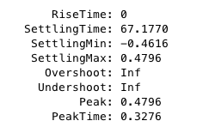
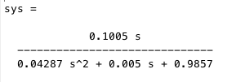
Matlab root locus normal rod pendulum
Always
stable
Open loop response is a damped sinusoid

Slide 41
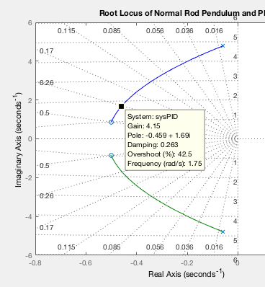
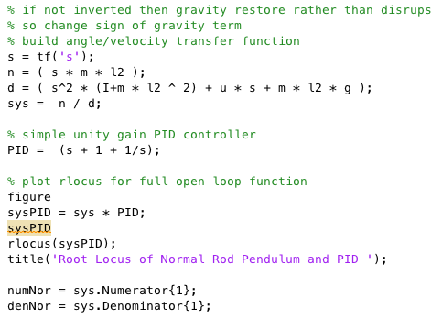
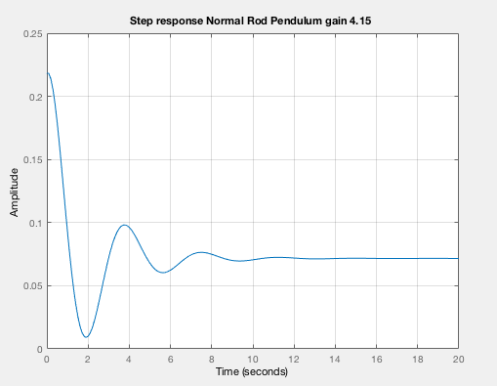
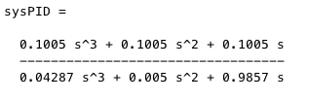
Matlab PID root locus normal rod pendulum
Always
stable
Step response

Slide 42
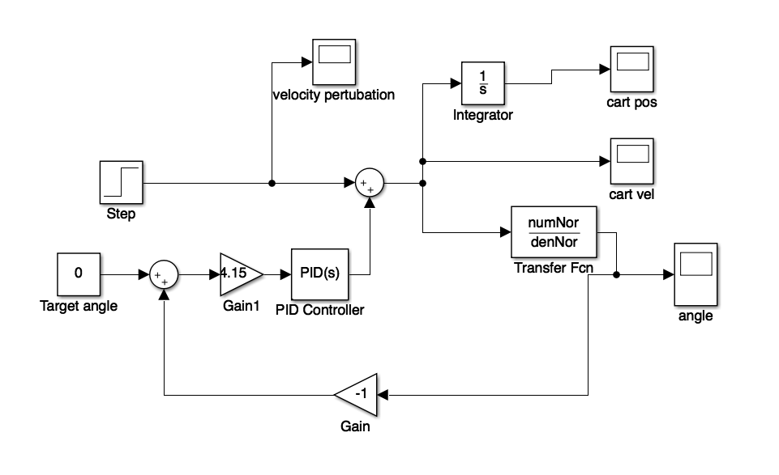
Simulink: PID with 4.15 gain
Add small
velocity disturbance
Set target angle
To 0 degrees

Slide 43
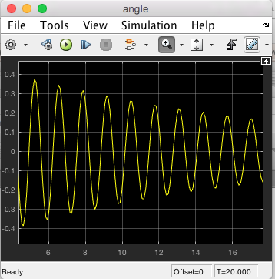
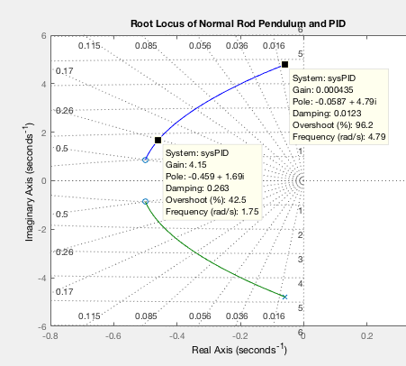
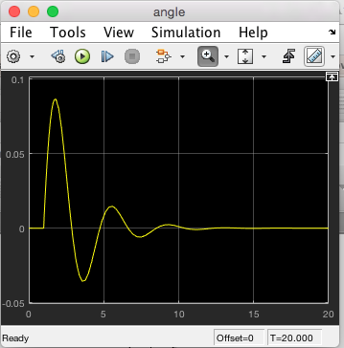
Normal rod pendulum angle

Slide 44
Interlude 10 minute break

Slide 45
ROCO218: Control Engineering Dr Ian Howard Lecture 10 Nyquist stability criterion

Slide 46
Nyquist Criterion background concepts
Bode stability criterion is based on Bode diagram of open-loop system
Used to determine the stability of closed-loop system
Nyquist stability criterion is based on the Nyquist diagram of the open-loop system
Also used to determine the stability of closed-loop system
Both determine the stability of closed-loop system on the basis of the frequency response of the open-loop system

Slide 47
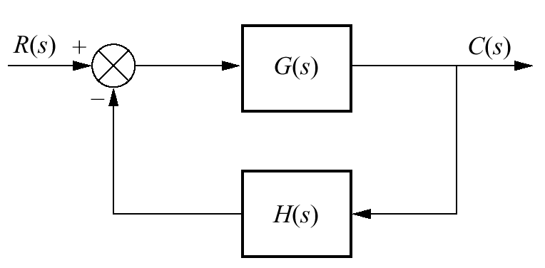
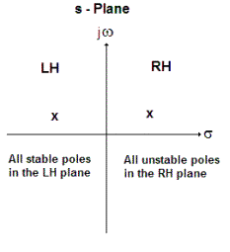
Nyquist Criterion background concepts
Transfer function
The transfer function T(s) has closed-loop pole on the right half of the s-plane, the system is unstable
To test for stability we need to check whether the characteristic equation has poles outside the left-half-plane
If there are no closed-loop poles on the right half of the s-plane, the system is stable

Slide 48
Nyquist plot
A Nyquist diagram is a plot of the frequency response on an Argand diagram
No detailed rules for sketching Nyquist diagrams
Suffices to determine the asymptotic behavior as angular frequency ω ➔0 and ω➔∞
Nyquist’s Stability Theorem allows us to deduce closed-loop properties, the location of poles of the transfer function
By consideration of the open loop frequency response of the return function
Main idea is we use –ve feedback to reduce error
But when fed-back 180° out of phase it becomes +ve feedback!
If gain >1 at this point the the system will become unstable!

Slide 49
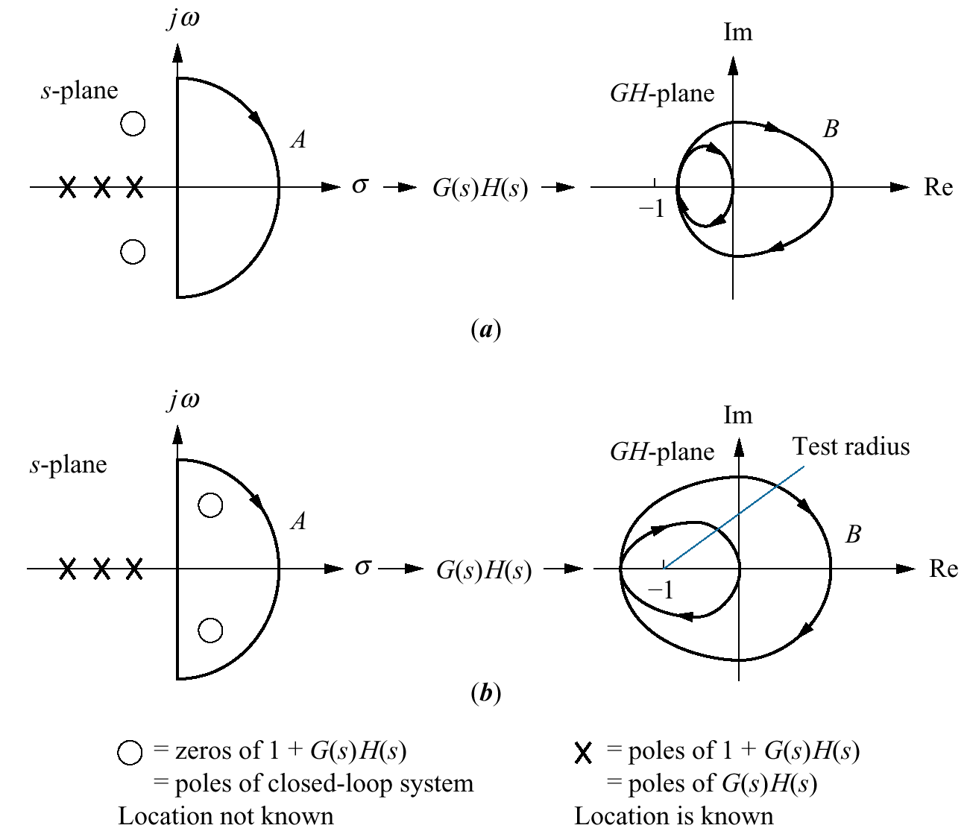
Mapping between s-plane and F(s)-plane
Follow this s-plane contour
This generates Nyquist contour

Slide 50
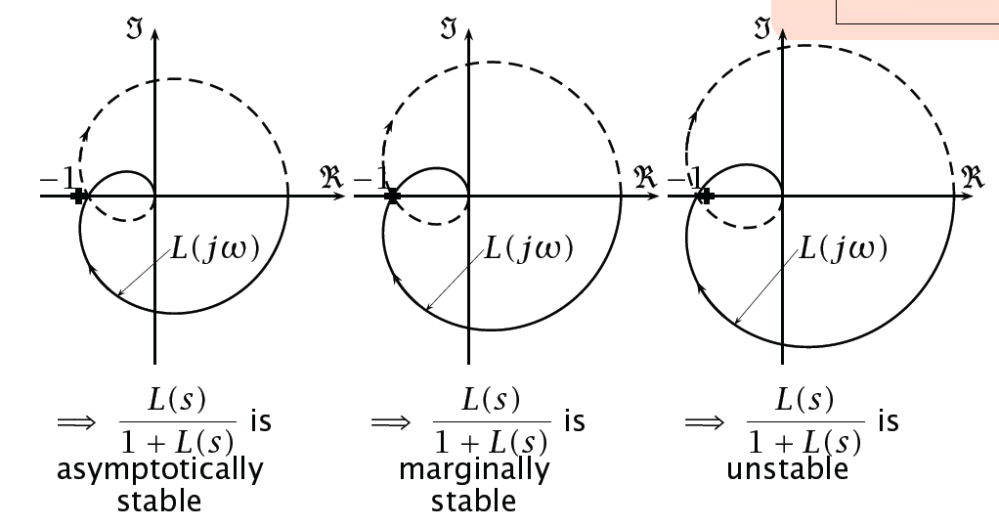
Using Nyquist plot in a nutshell
The closed-loop system is stable if the Nyquist diagram of the return ratio doesn’t enclose the point “−1”

Slide 51
Using Nyquist plot in a nutshell
Closed-loop system is stable if the Nyquist diagram of the return ratio doesn’t enclose the point “−1”

Slide 52
Using Nyquist plot in a nutshell
Closed-loop system is stable if the Nyquist diagram of the return ratio doesn’t enclose the point “−1”

Slide 53
Encirclement of -1
The reason the closed-loop system is stable if the Nyquist diagram of the return ratio
doesn’t enclose the point “−1” is as follows:
If the Nyquist locus passes through the point “−1” then G(s)H(s) = 1
That is we have a +ve real pole at 1 so the system is unstable
The closed-loop frequency response T(s) becomes infinite at that frequency
There is thus a sustained oscillation of the feedback system even when there is no external input

Slide 54
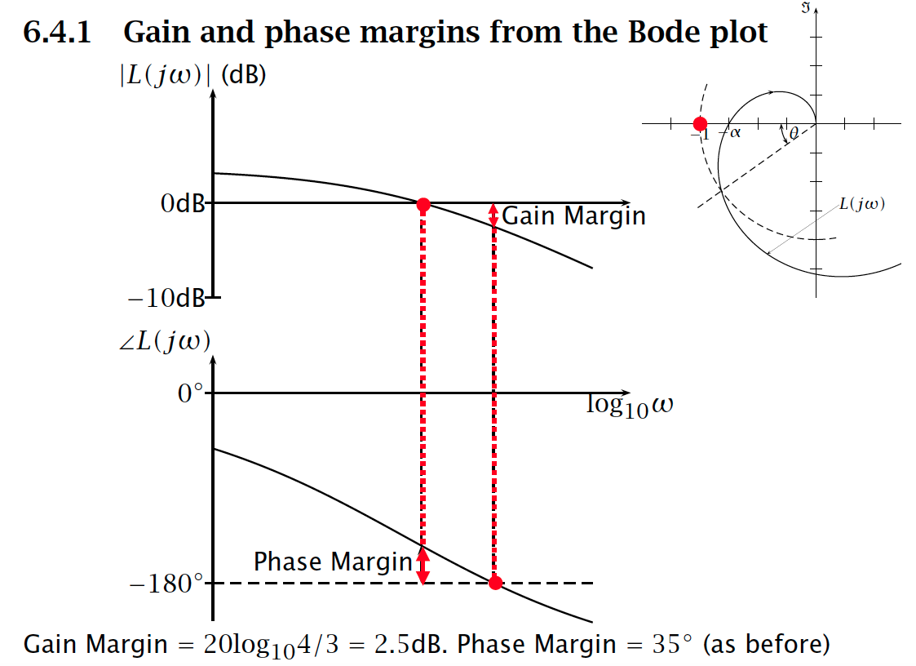
Compare Nyquist and Bode margin plots
We can read off gain and phase margins from a Bode plot

Slide 55
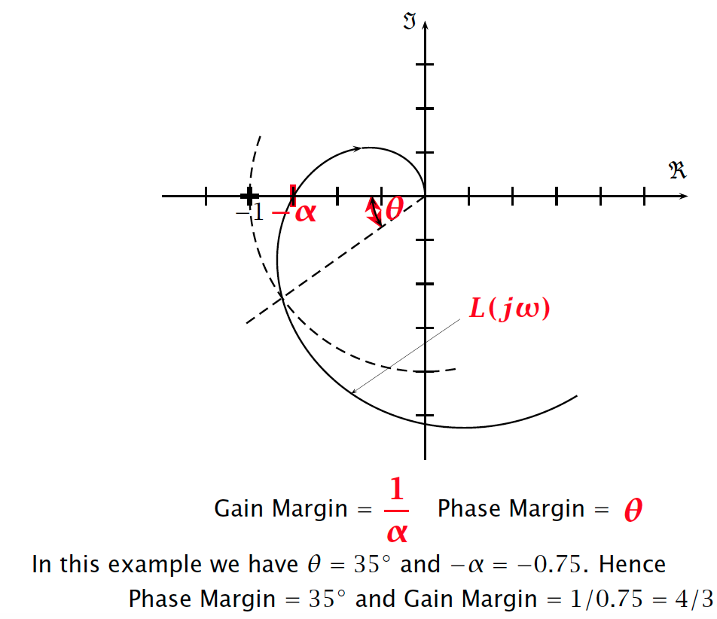
Nyquist plot gain and phase margin
Similarly we can read off gain and phase margins from a Nyquist plot

Slide 56
ROCO218: Control Engineering Dr Ian Howard Lecture 10 Pendulum analysis using KE and PE

Slide 57

Fixed point mass pendulum
Consider the conservation of energy within a swinging pendulum
In the absence of any losses use to friction, when the system is initially pushed from equilibrium it will oscillate
It will swing from side to side
It will reach zero velocity at the top of each swing
It will reach peak velocity at its lowest position
There will be an exchange between kinetic energy (KE) and potential energy (PE)
And the total energy will therefore be a constant.
We shall represent total energy by K

Slide 58
Fixed point mass pendulum
Total energy within the pendulum will be given by
The kinetic energy term KE is given by
Where I is the moment of inertia of the point mass and ω is angular velocity
For a point mass
The potential energy term PE is given by
Where m is the point mass mass, h is its height and g is the acceleration due to gravity
Taking the origin at the pivot then the height h is given by

Slide 59
Fixed point mass pendulum
Consideration of total energy in the pendulum results in the equation
Differentiating both sized to get rid of constant
Now

Slide 60
Chain rule for single variable differentiation
Consider the one variable equation corresponding to a function of a function
For example if
In this case let
Writing
Chain rule gives

Slide 61
Fixed point mass pendulum
Consider the term
So using chain rule writing
Letting
Therefore

Slide 62
Fixed point mass pendulum
Consider the term
So using chain rule writing
Letting
Therefore

Slide 63
Fixed point mass pendulum
Therefore the expression
Trivial solution is then when pendulum stationary
Simplifying expression for non-trivia solution

Slide 64
ROCO218: Control Engineering Dr Ian Howard Lecture 10 Topics we haven't covered

Slide 65
Additional topics in control engineering
System analysis using the Euler–Lagrange equation
Deriving system differential equations by consideration of energy
Dealing with time delays
Smith predictor
Digital sampled-time systems
Z-transform rather than Laplace transform
Discrete rather than continuous state space models
Dealing with controllable and unobservable systems
Use Kalman decomposition to find stabilizable and detectable parts of the systems
The Kalman filter for optimal state estimation
Stochastic approach whereas Luenberger is deterministic
System identification
Learning the plant kinematics and dynamics and optimal control gains and strategies from experience
Plus lots more…….

